Slide 1
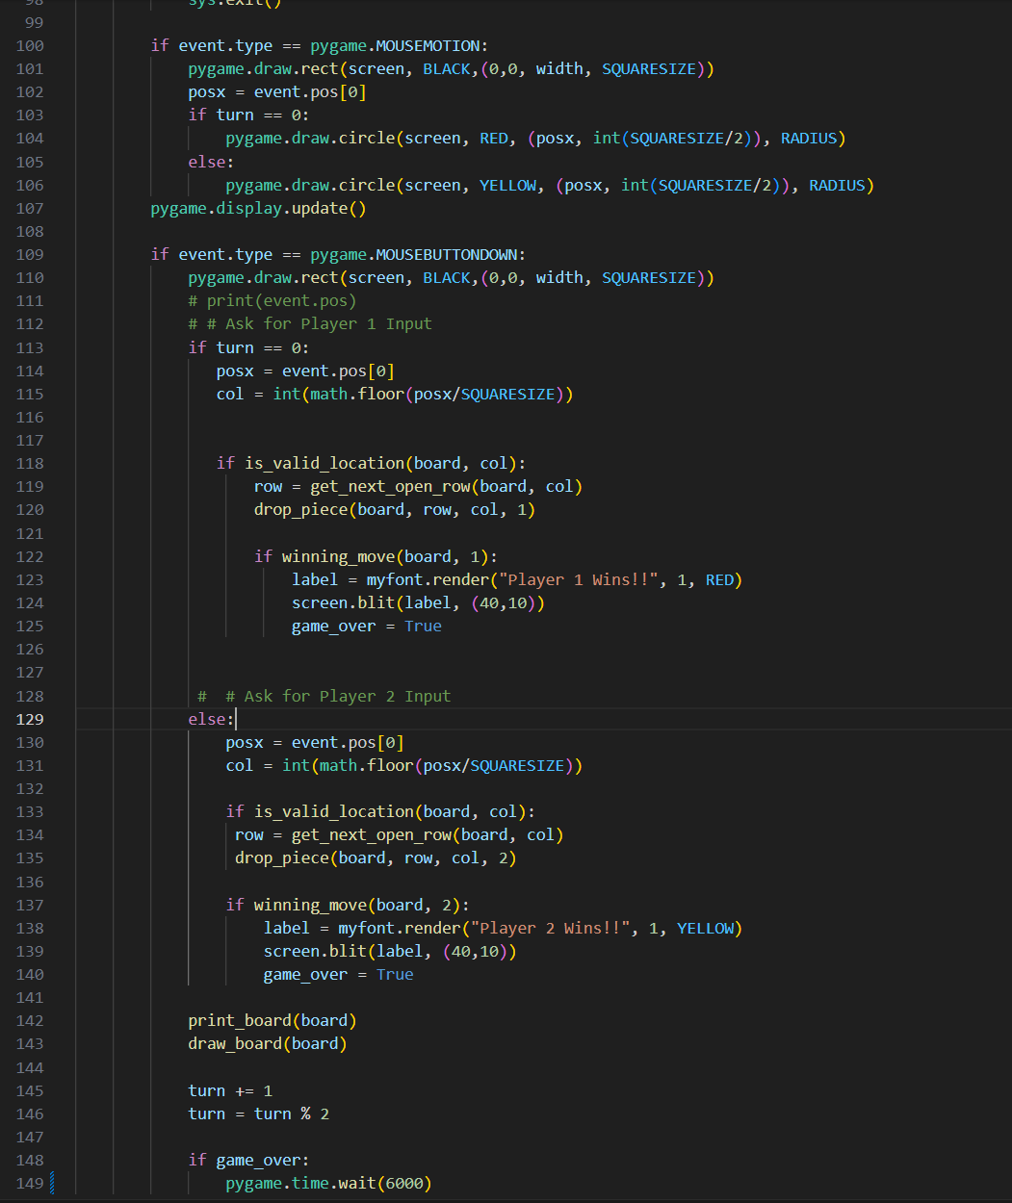
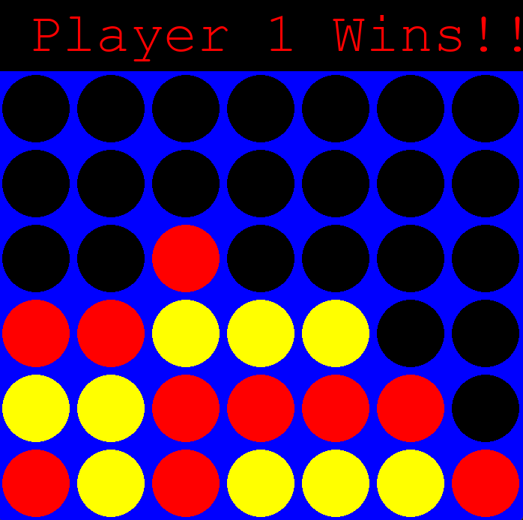
CONNECT 4
Four in a row, coded in Python
AXEL VASQUEZ

